Slide 1


®
IBM Software Group
Essentials of Visual Modeling with UML 2.0
Module 1: Introduction to Object Technology

Slide 2
Objectives
Define object technology and show its strengths.
Explain the history of object technology.
Discuss how object technology is used today.
Notes:
Introduce the course objectives to the students.

Slide 3

Where Are We?
What is object technology?
Where is object technology used today?
Notes:
Explore the student’s knowledge of object technology.

Slide 4
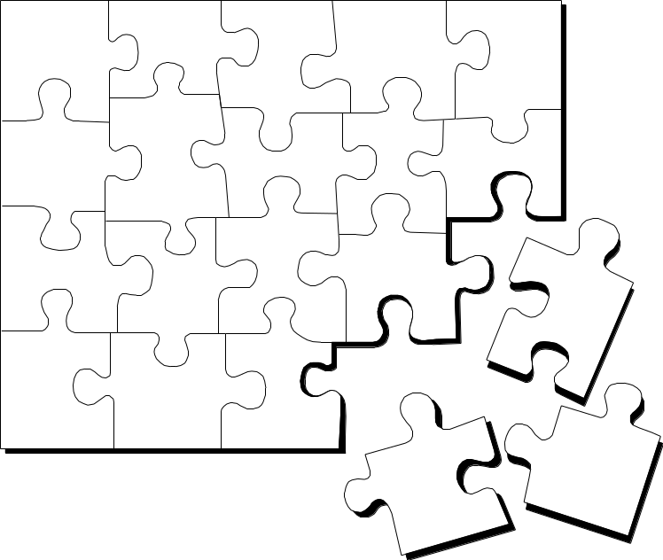
What Is Object Technology?
A set of principles (abstraction, encapsulation, polymorphism) guiding software construction, together with languages, databases, and other tools that support those principles. (Object Technology - A Manager’s Guide, Taylor, 1997.)
Notes:
Object technology is used for creating models that reflect a specific domain using the terminology of the domain.
Models created using object technology should be easy to create, change, expand, validate, and verify.
Systems built using object technology are flexible to change, have well-defined architectures, and have the opportunity to create and implement reusable components.
Models created using object technology are conveniently implemented in software using object-oriented programming languages.
Object technology is not just a theory, but a well-proven technology used in a large number of projects and for building many types of systems.
Successful implementation of object technology requires a method that integrates a development process and a modeling language with suitable construction techniques and tools. (UML Toolkit, Eriksson and Penker, 1997.)
Provide a high-level definition of object technology. Keep in mind that this is all new to most of your students.
Share with the students your excitement about OO. Object technology is not simply the use of an object-oriented language like Java or C++. It is based on the principles of abstraction, modularity, hierarchy, and encapsulation.
If an organization is to successfully implement object technology, they must use more than a language. They must also use process, a modeling language (UML), data modeling techniques, and so on.

Slide 5
The Strengths of Object Technology
Reflects a single paradigm
Facilitates architectural and code reuse
Reflects real world models more closely
Encourages stability
Is adaptive to change
Notes:
So what’s the big deal about object technology? Why has the software industry made such a noticeable shift to object-oriented languages like Java? Much of the answer has to do with the strengths of object technology. There are some people who believe that object technology is a passing fad and will quickly go away, while others believe that object technology is the silver bullet that answers all software development problems. The truth is that the answer probably lies somewhere in between. Object technology is a powerful and challenging way to develop software. The result of this hard work can be a software system that:
Reflects a single paradigm. It provides a consistent language that can be applied for both system and business engineering.
Facilitates architectural and code reuse by clearly articulating the major components and the critical interfaces between them.
Reflects real world models more closely. The objects themselves often correspond to phenomena in the real world that the system is to handle.
Is more stable, a change to the system can be localized to a small part of the system.
Is adaptive to change -a small change in requirements does not mean massive changes to the system.
Emphasize the importance of object technology.
Object technology is NOT easy. It is a highly disciplined way of approaching a software problem. However, the approach can reap benefits over other ways of approaching software development.

Slide 6
The History of Object Technology
Major object technology milestones
Simula
C ++
The UML
1967
Late 1980s
1996
1972
1991
2004
Smalltalk
Java
UML 2
Notes:
Object technology is not a new idea. It has been around for over 30
years. Below is a brief history of the major milestones in the history of object technology.
In 1967, Simula was designed and became the first language to use objects and classes.
In 1972, Alan Kay and others at Xerox PARC created Smalltalk whose roots were tied to Simula. In 1980, Smalltalk became the first commercial release of an object-oriented programming environment.
Bjarne Stroustrop, the originator of the C language, released C++ to the public in the late 1980’s. C++ was not an entirely new language, but an extension of C abilities.
In 1991, James Gosling created a language named Oak that was the predecessor to Java. It was created because his development team at Sun Microsystems was writing software for information appliances. He found that C++ was too complex and insecure for the job. Therefore, he created the Oak language.
UML 2.0 replaces UML version 1.4. Released in 2004, the Object Management Group (OMG) developed two complementary specifications called the Infrastructure and Superstructure specification. The Infrastructure defines the foundational language constructs required for UML 2.0 and serves as an architectural foundation. The Superstructure defines the user level constructs. Together, they constitute a complete specification for the UML 2.0 modeling language.
Review these milestones with the students so that they garner a perspective on object technology’s history.
This slide was included to show students that object technology is not new. It has been around for a long time and is a proven and fairly mature technology.

Slide 7
Where Are We?
What is object technology?
Where is object technology used today?

Slide 8
Where Is Object Technology Used?
Client/Server Systems and Web Development
  Object technology
  allows companies to encapsulate business information in objects and helps to distribute processing across the Internet or a network.
Notes:
Object technology allows companies to encapsulate business information in objects and helps to distribute processing across the Internet or a network. Enterprise development environments such as Sun’s J2EE and Microsoft’s .Net technologies use objects as the basis for their technology.
Demonstrate that object technology is used in many client/server applications today.
If you have a “war-story” or an experience that you had working on a Web or client-server application that successfully used object technology, share it here.
This is not just for traditional 2-tier client/server systems, but also N-tier systems such as large scale Web applications.

Slide 9
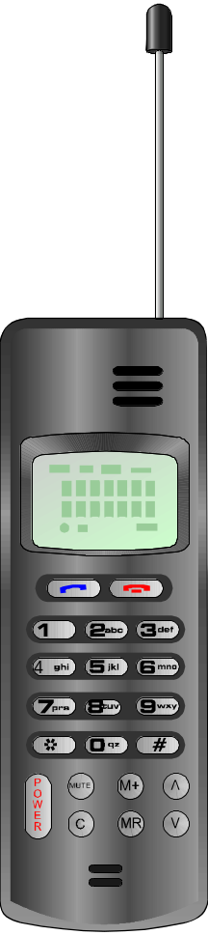

Where Is Object Technology Used? (continued)
Real-time systems
  Object technology enables real-time systems to be developed with higher quality and flexibility.
Notes:
Object technology is used in the following industries and software applications:
Telecommunications – circuit switching systems, wireless systems, transmission systems, satellite systems, fault management, call/connection control, and protocol development.
Data communications – LAN hub switches, multi-protocol routers, packet switching & frame relay, ATM switching systems, connection control, node management, fault management, and protocol development.
Defense and aerospace – command and control systems, missile control systems, defense simulators, cockpit control systems, air traffic control systems, target tracking, distributed computer modeling, man machine interface control, communication modes and control, redundancy management.
Industrial control – office equipment, factory control systems, multi-processor high speed printers, automotive systems, PWB and IC water fabrication, device control, system management, distributed process control, machine position control, bandwidth allocation.
Demonstrate that object technology is in many real-time applications today.
If you have a “war-story” or an experience that you had working on a real-time system that successfully used object technology, share it now.
People don’t often think of real-time development using objects. However, both active objects and state machines are used to model real-time systems.

Slide 10
Differences Between OO and Structured Design
Object-orientation (OO)
  Melds the data and data flow process together early in the lifecycle
  Has a high level of encapsulation
  Promotes reuse of code differently
  Permits more software extensibility
Notes:
In the world of structured design, there has always been an uneasy relationship between the data model in an entity-relationship diagram and the dataflow diagram. The dataflow process and the data meet in some places, but in not others, they miss each other altogether. Object-orientation (OO) melds the data and dataflow process together early in the lifecycle. In object-orientation, concern yourselves with defining the static and dynamic views of the system (Jones, p.65).
Object-orientation has a very high level of encapsulation associated with it. Data, operations, and entire classes can be encapsulated. Structured programming relies upon data structures, sophisticated algorithms, and elaborate relationships between procedure and data (Jones, p.65).
Object-orientation promotes reuse of code at the class level rather than at the level of the individual subroutine (Jones, p. 66).
The goal of extensible software is to share a solution that most closely fits the problem. By doing this, you can ensure that a small requirements change doesn’t require major modifications to your system. Because object orientation is built using classes that are abstractions of actual business objects, OO techniques come closer to permitting software extensibility than structured design.
Offer a comparison between structured design (where many of your students have experience) and Object Orientation (OO).
This slide is not meant to attack the structured design world. Many of the techniques and models that are used in structured design are the basis for the UML and the processes that are used to build OO systems.
However, OO has taken the best techniques from structured design and addressed some of the basic problems to arrive at a better solution.

Slide 11
Discussion
What is your perception of object technology?
What do you perceive as object technology’s strengths? Its weaknesses?
Why are you making the shift to object technology?
Notes:
This slide gives you the opportunity to find out what your students know about object technology. What are their preconceived ideas?
Listen closely, as it may help you shape the direction that the class takes.
It’s important to record the student’s concerns at this time. Try to address these issues at the appropriate time in the course. This is a good opportunity to find out if you need to supplement the slides in any particular area.

